Slide 1
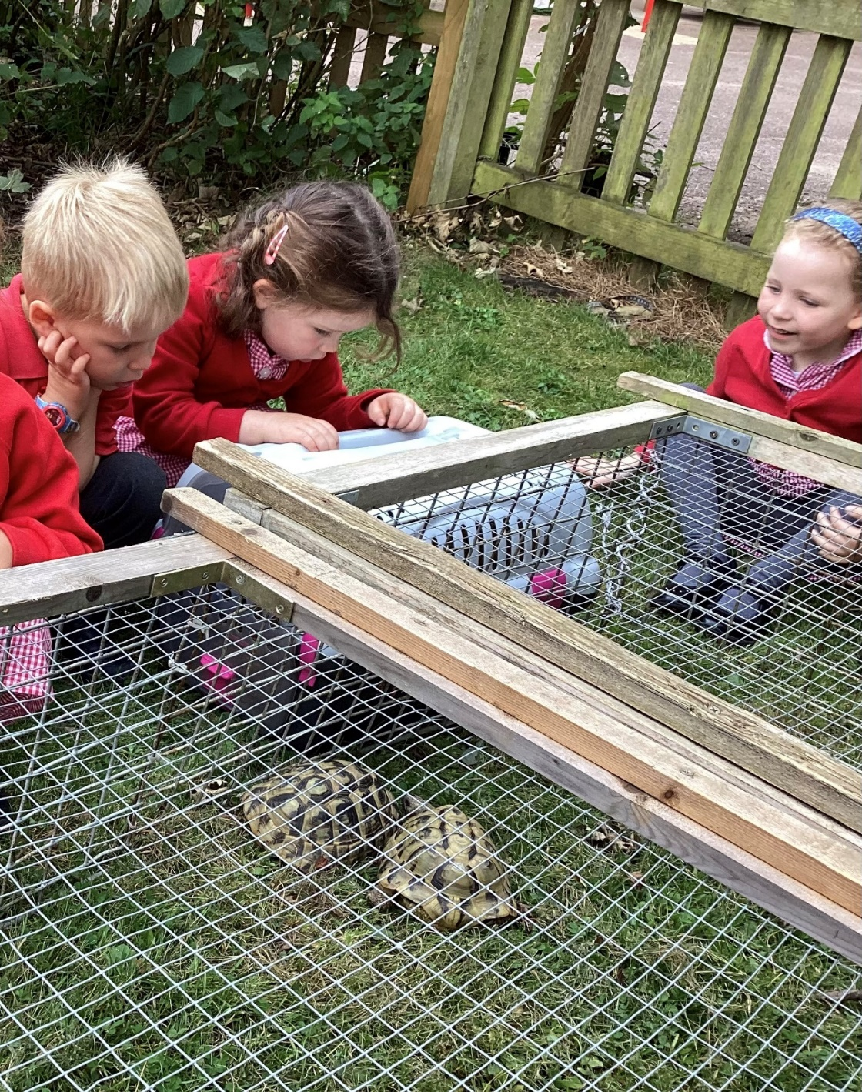
Watlington Early Years

Slide 2
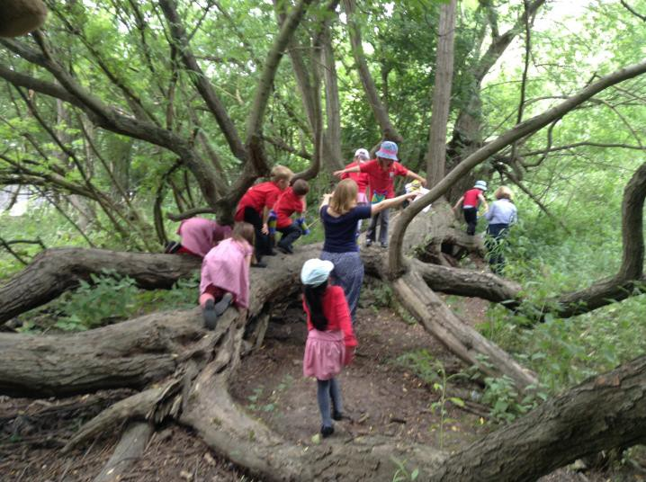
share our ethos about learning in early years
give you some of the rationale behind our approach
share the key areas of the early years framework
give you an insight into what your child will experience with us
provide you with practical ideas use at home
Our aims

Slide 3
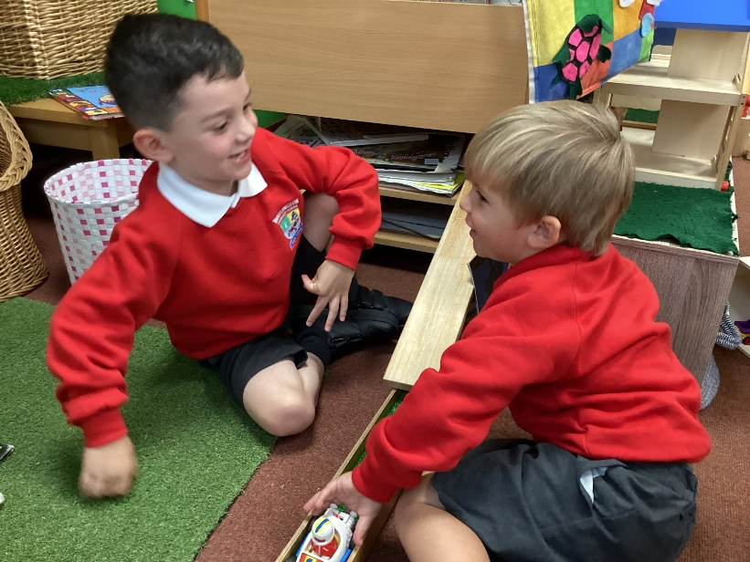
Get to know you and your child
Assess your child from their starting point
We then plan to make sure they have an exciting and challenging learning experience with us
Ongoing observations, tracking and assessments
We will contact you if we have any specific concerns, ‘no news is good news!’
From the
start ….

Slide 4
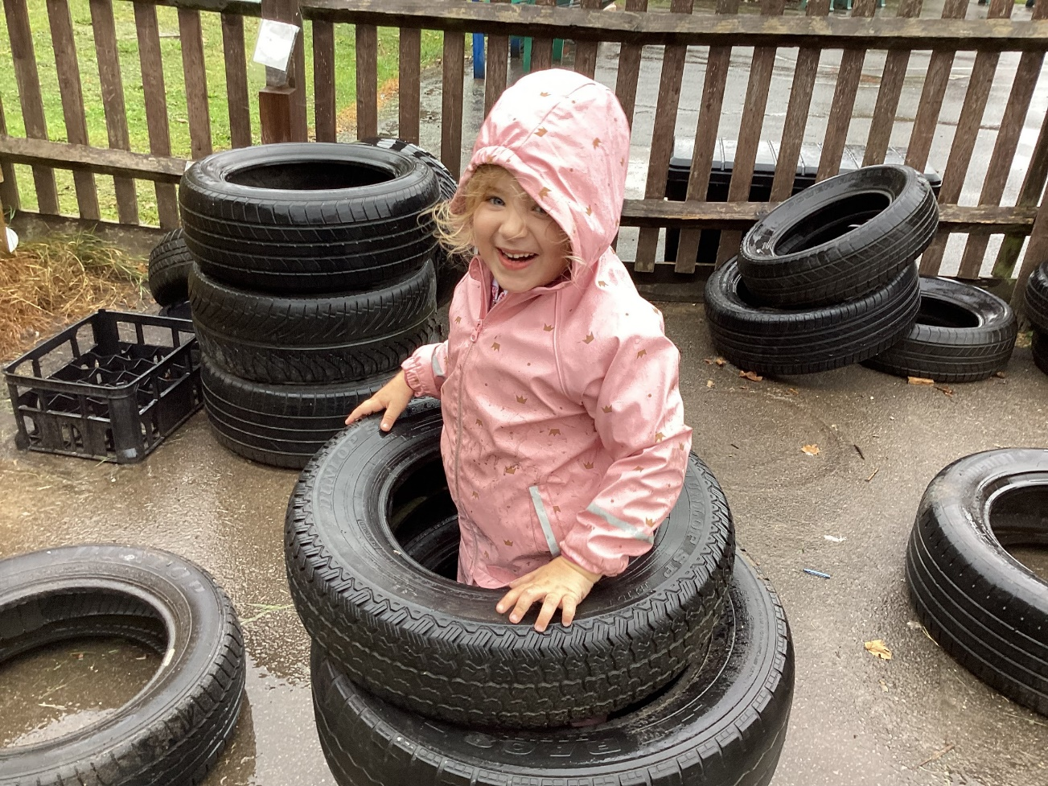
We use:
‘All about me' form
Observations
Leuvens - wellbeing
Baseline
Language screening (WellComm)
Our own initial assessments

Slide 5
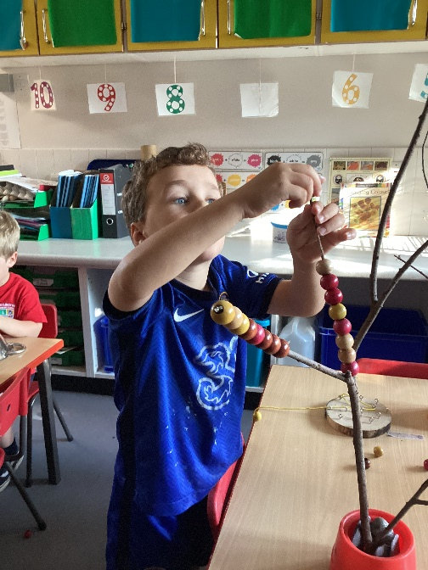
The Principles
The Early Years Framework 2021
1. Unique child
2. Positive relationships
3. Enabling environments
4. Learning and development

Slide 6
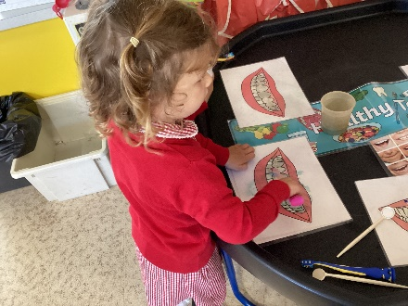
There are 3
Prime Areas
Communication and Language
Personal, Social and Emotional development
Physical development
A new change in the EYFS framework - promote “good oral health of children”
Public Health England that suggests that 1 in 5 children aged 5, have experienced tooth decay

Slide 7
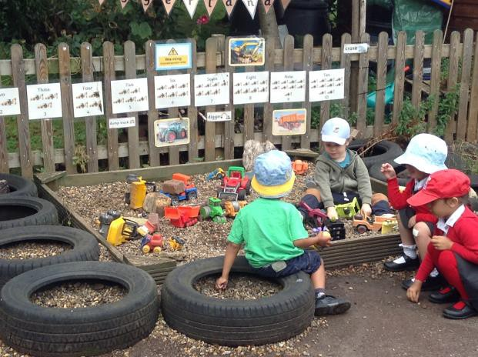

Slide 8
The ‘million word gap’
That’s how many fewer words some children may hear by kindergarten (starting school).
Young children whose parents read them five books a day enter kindergarten having heard about 1.4 million more words than children who were never read to.
This ‘million word gap’ could be one key in explaining differences in vocabulary and reading development.
Date:
April 4, 2019
Source:
Ohio State University

Slide 9
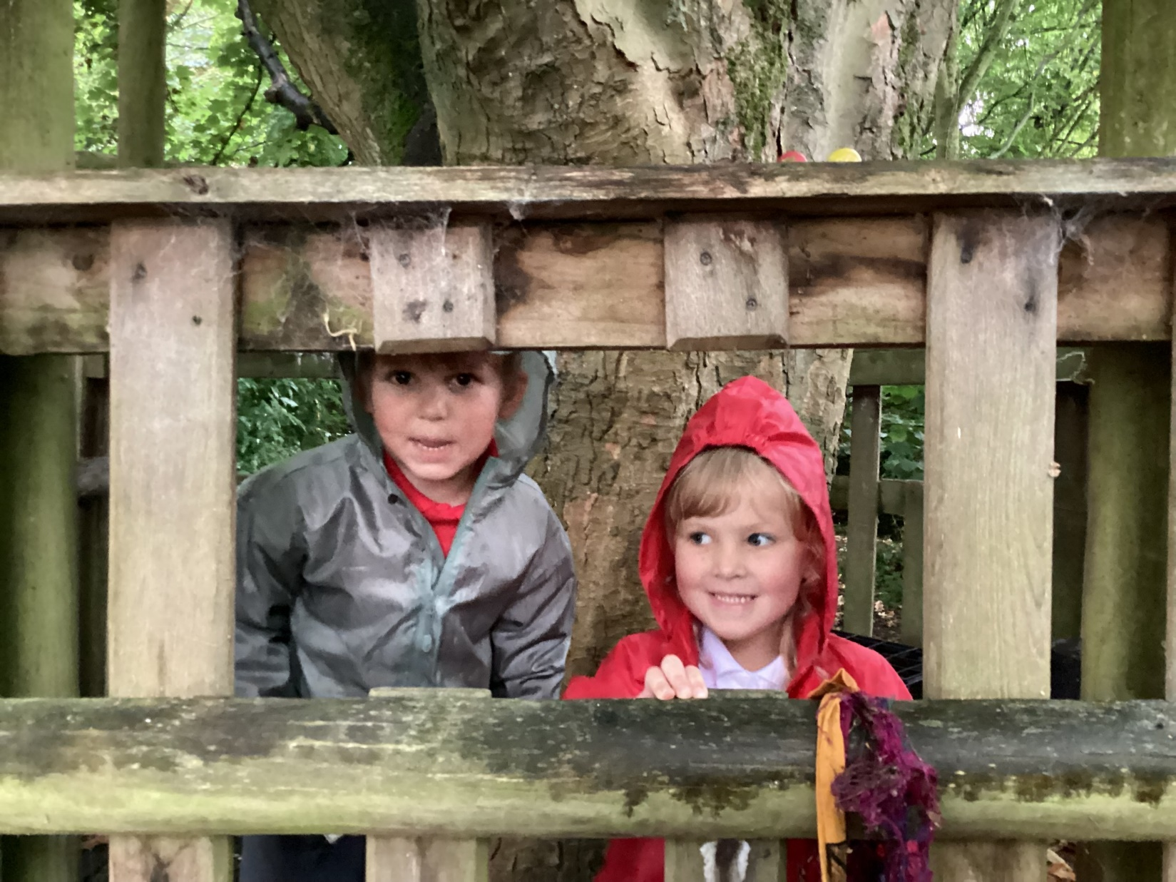
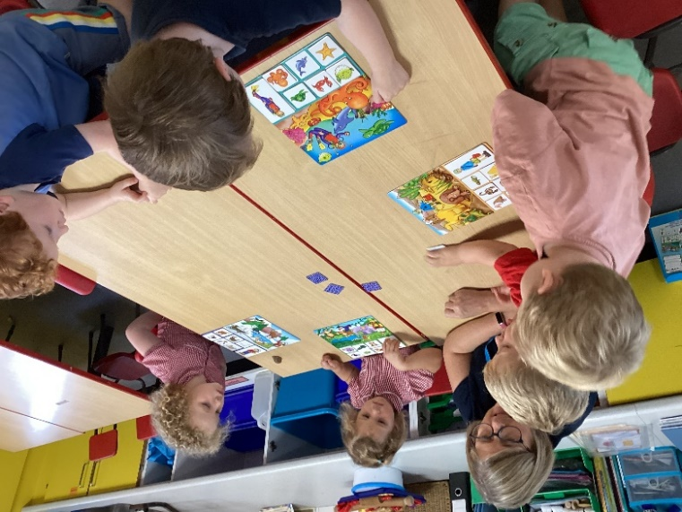
We are seeing a decline in children’s home experiences of talking, singing, and learning nursery rhymes. As children’s engagement in playing with phones and tablets rises, the focus on play and talking diminishes.
‘Speaking and Language skills are on the decline'
(Nursery World article, Building your Curriculum –
Communication
and Language – April 2020)
In 2017, Ofcom reported that nearly half of children aged 3 to 4 years, use YouTube. More than half are online for 8 hours a week.
Screen use has been found to start as early as six months of age. One in five children aged between three and four years old have their own mobile phone, increasing to one in four children by age eight and to almost all children by age 12.

Slide 10
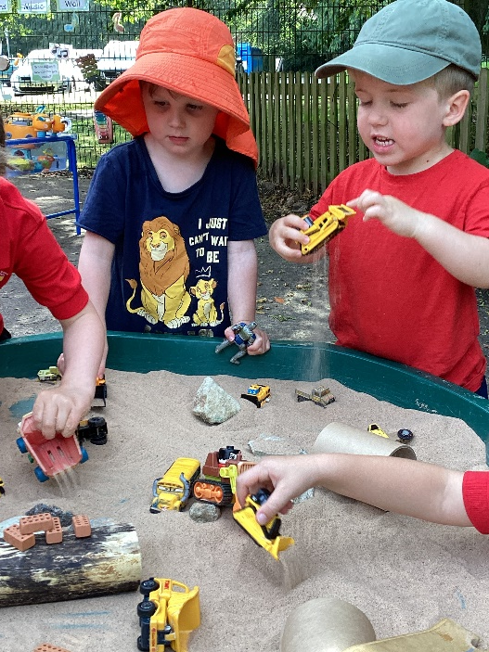
What does language rich look like?
Correct modelling of speaking, listening, reading and writing (speech sounds)
Shared experiences – day to day
New vocabulary introduced and explained/ explored
Opportunities to talk and be listened to – language developed/ modelled
Range of texts to develop language – from different cultures, magazines, newspapers, non-fiction as well as fiction. New and different authors. Library visits
Rhymes, nursery rhymes and songs

Slide 11
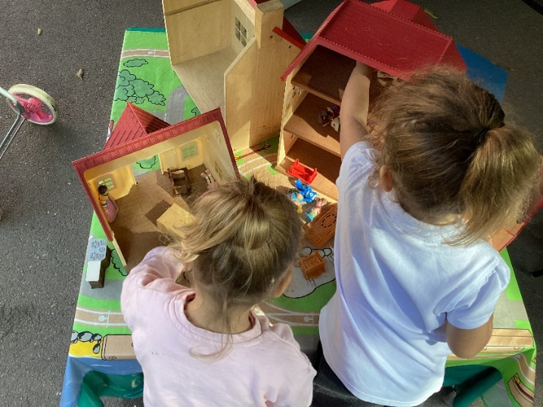
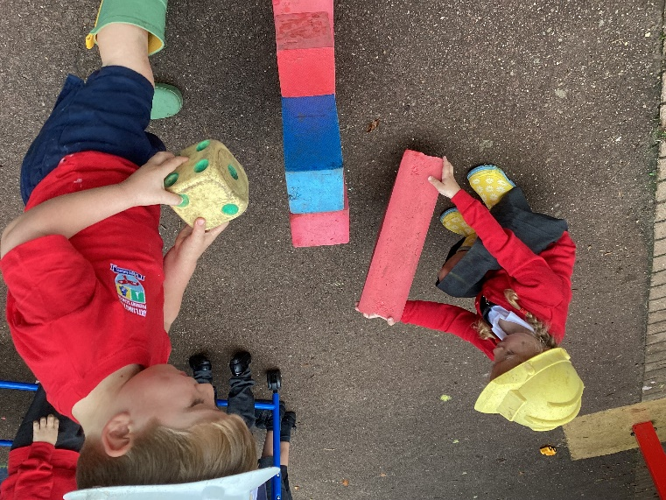
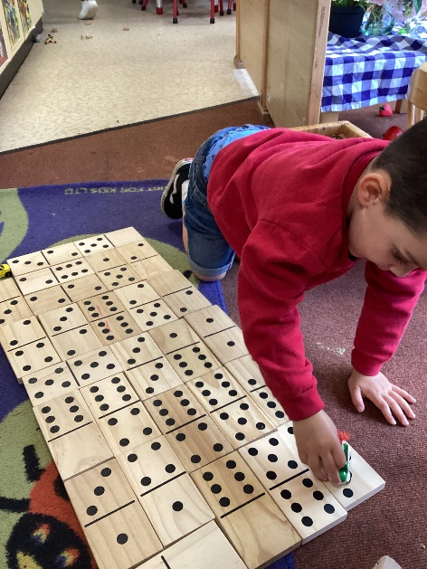
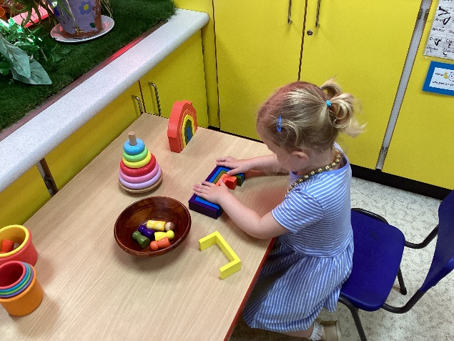
-Maths

There are 4 Specific areas
-Literacy
-Understanding the World
-Expressive Arts and Design

Slide 12
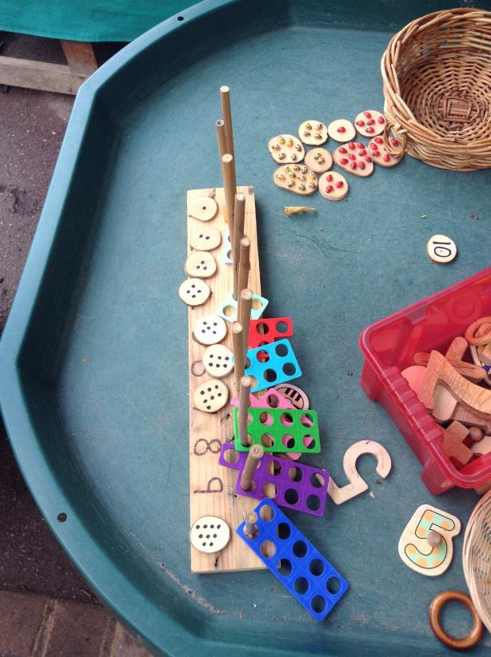
Maths
We follow the Maths Mastery approach, aimed at securing a deeper understanding of number and number patterns.
Children learn to:
Subitise
Count on fingers
Count with accuracy
Identify, sequence and write numerals
Discuss more / fewer and make comparisons
Explain their thinking
Develop reasoning skills
Represent their thinking and learning through pictures, photos and written methods.
Numbers
Numeral Patterns

Slide 13
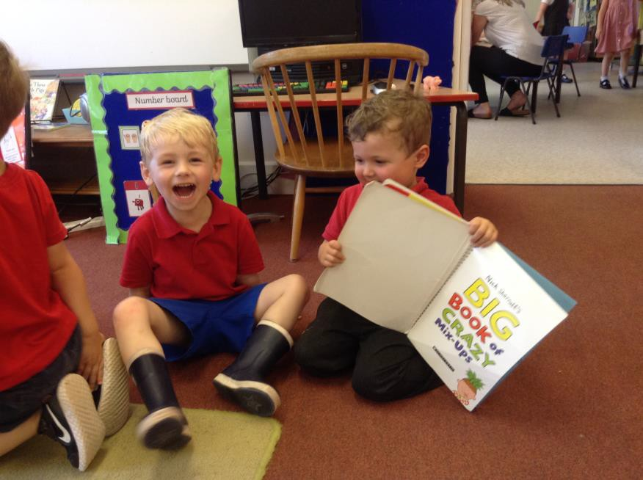
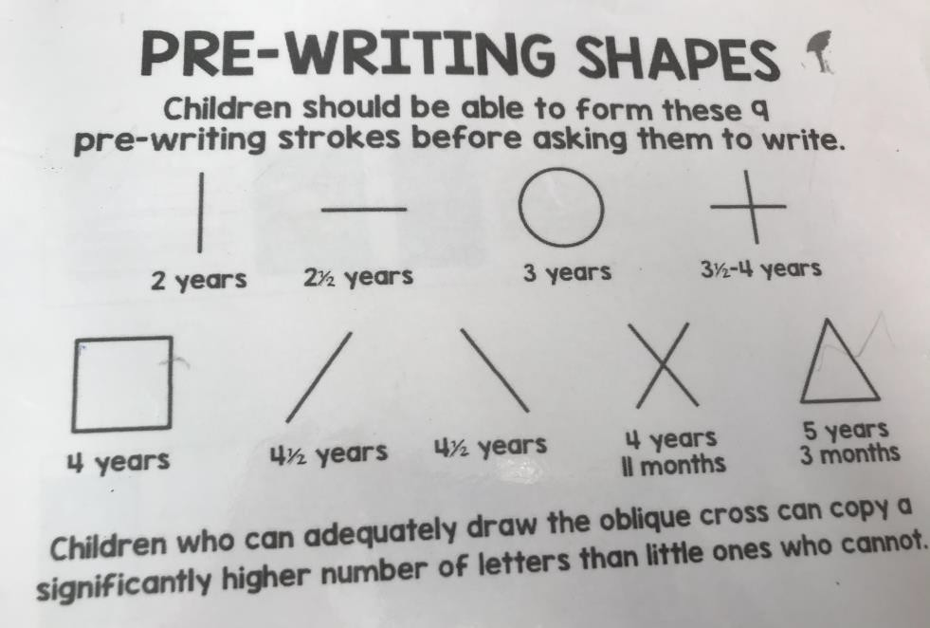
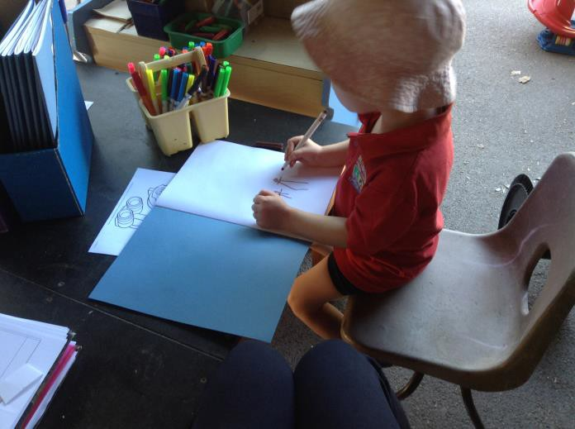
“From the day our children are born (yes), to the day they tell
us to stop, we should read to them,” (Michael Rosen)
Literacy
Talking about and sharing book
Print in the environment
Early mark making and writing

Slide 14
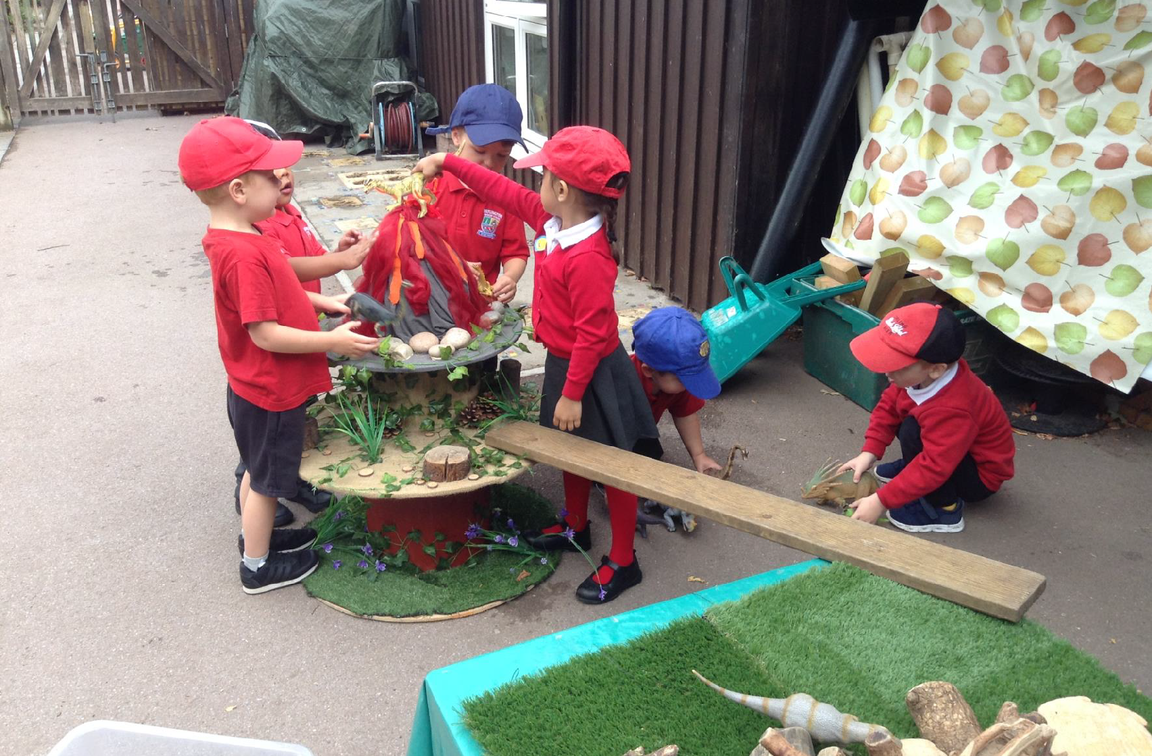
‘Before children write a story, they need to play a story’

Slide 15
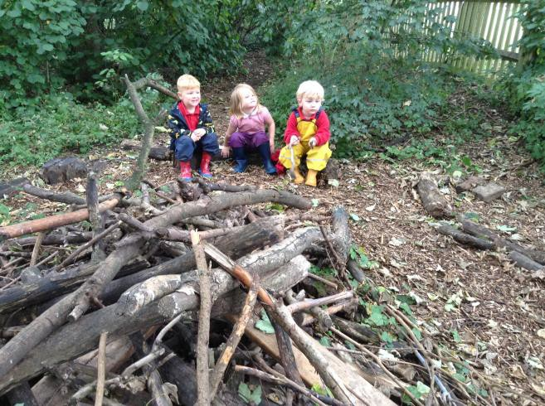
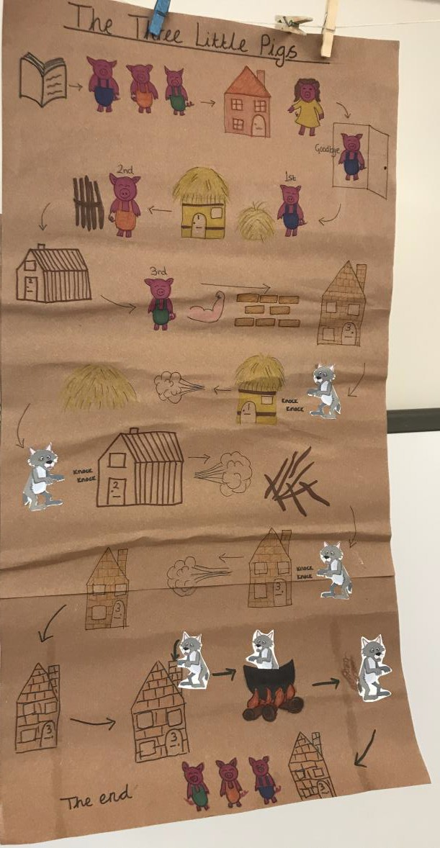
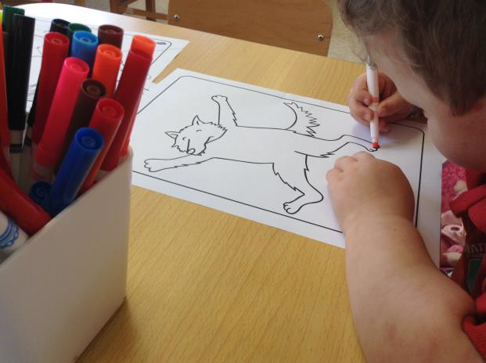
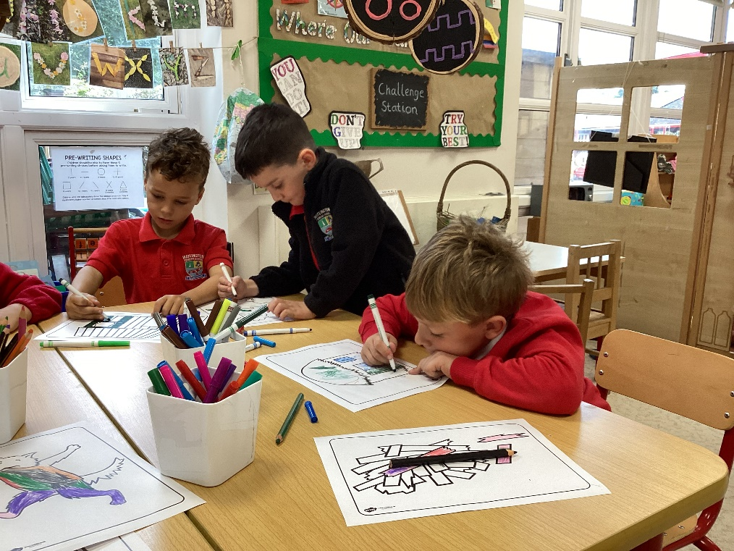
Immersing ourselves into a story …
Using actions
Mapping / sequencing
Reciting together
Role play
Using our own ideas
Talk 4 Writing

Slide 16
Phonics
Nursery Class – Phase 1 (Listening, Rhyme, Rhythm, Music, Alliteration, Blending sounds)
Reception following Early Letter Sounds (ELS) - starting from Phase 2. Introduce letter sounds and shapes which build to make words - s-a-t,
p-a-t, p-i-n, t-i-n
Children learn to write the letter shapes – not cursive.
Secret to success – GOOD LISTENING! This starts at home.

Slide 17
Phonics
Phase 1 – teaches children to listen to familiar sounds and distinguish one sound from another
Strong focus on listening, rhyming and saying the sounds
Flexible phonics groups – assessed on a regular basis
Direct teaching AND exploring through play

Slide 18
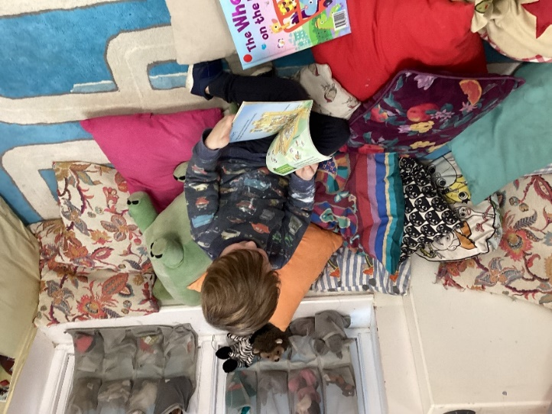
Learning to read
Reading less than weekly to a three-year-old is associated with a child being four months behind a child who was read with daily when they were three.

Slide 19
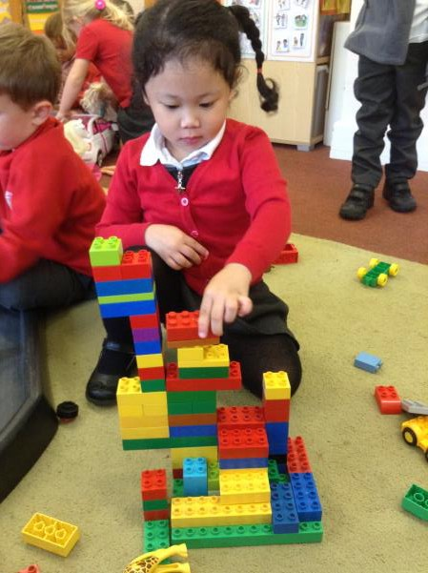
Building up sounds isn’t easy!

Slide 20
“Nothing lights up a child’s brain like play.” ~ Dr Stuart Brown, M.D.
“Did you know that the most important interactions you have with a child can happen through play? By engaging in playful serve and return with a child, you can literally help build stronger connections in the brain. Strong neural connections are the foundation for all of a child’s future learning, behavior, and health.”
- UNICEF, Director Jack P. Shonkoff, M.D.”
Why a play based approach?

Slide 21
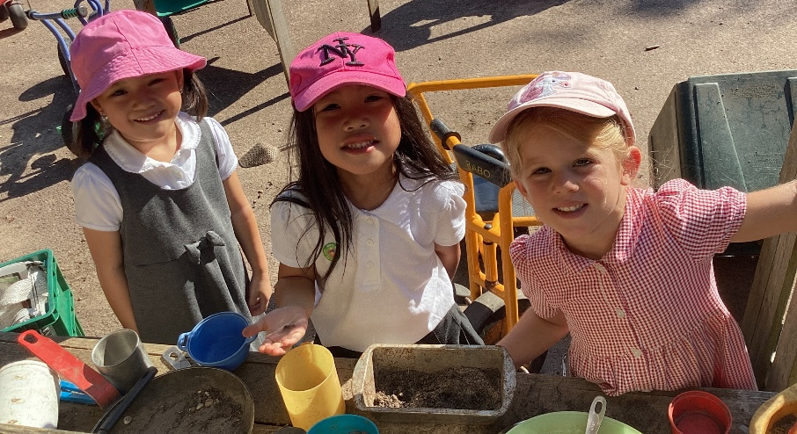
Playing IS learning
Might look like ‘just playing’
Valuing children playing and extend upon opportunities – take their lead
The environment is carefully planned to
develop children’s progress
Challenging activities to support learning
Careful balance between adult and child led learning
How do the teachers support this?
Opportunities for play based learning continues into KS1

Slide 22
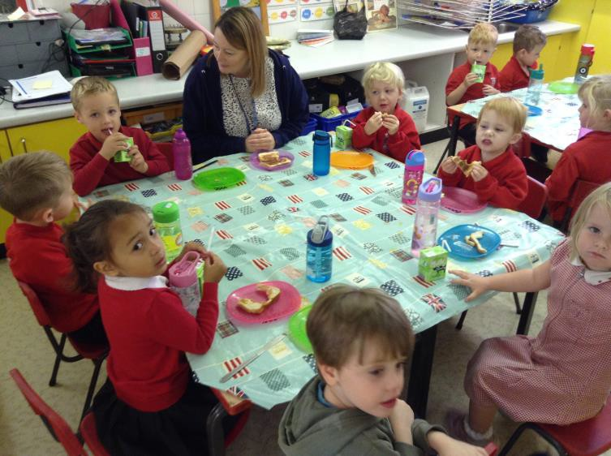
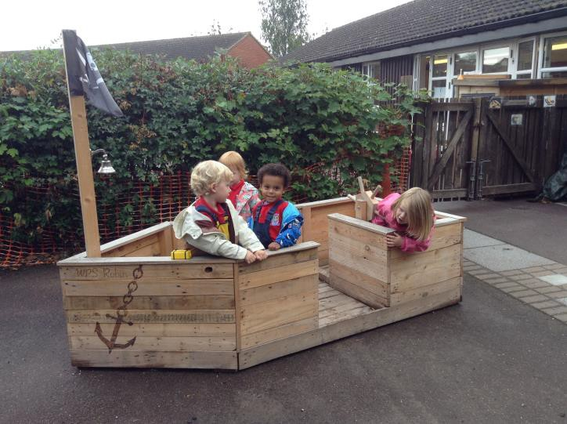
Structured routines – visual timetables used to support all learners.
Time for free flow play
Adult led and child led opportunities
Rich questioning opportunities to develop children’s learning extending ideas and vocabulary
What does this look like?

Slide 23
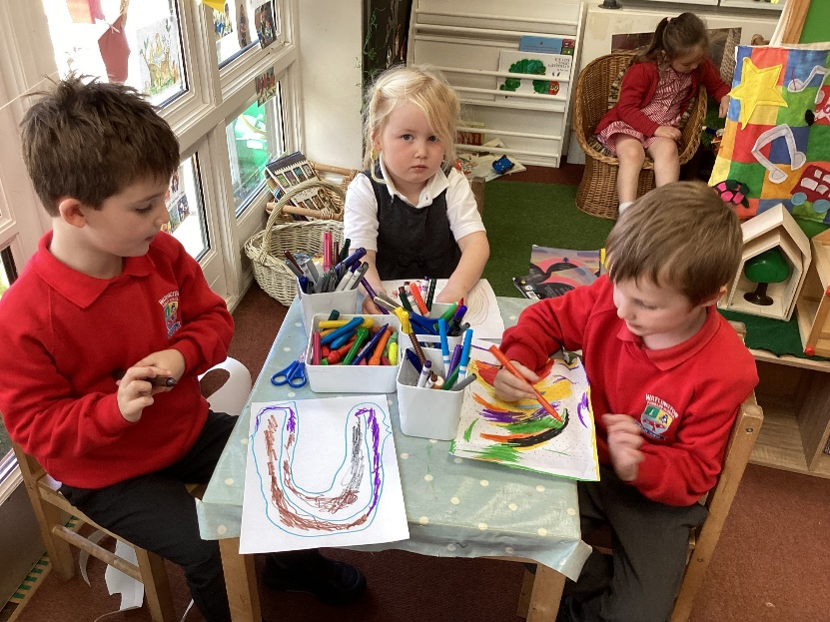
We
will…
Provide a motivation and exciting learning environment
Treat your child as a unique child
Work with you – ready to answer questions
Speak with you about any concerns we have

Slide 24
Check the class webpage regularly
Use class emails
Check your child’s book bag daily
Where possible, attend the open afternoons
Establish a good routine at home
Develop healthy lifestyle choices together
Try to set limits to screen time
Contact us with any questions, however small
Work with and support us
Register with a local dentist!
Reception:
Yellow reading diaries are used to communicate and both these and reading books are brought into school daily
Engage in the home learning
How can you help?
Robins@watlington.oxon.sch.uk Hedgehogs@watlington.oxon.sch.uk

Slide 25
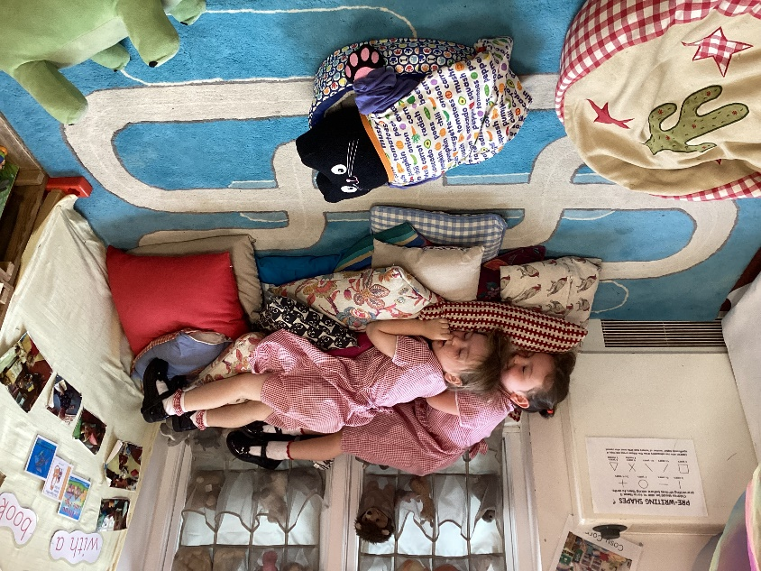
Bookstart
Spot numbers when out and about and talk mathematically
Teach your monster to read
Local library
Count everything – knives and forks, fruit, socks…
Bedtime stories – every night
Story CDs at home/ in the car
Outside learning, enriching visits and experiences and day to day stuff…. walks, playing at the park, visiting family, cooking, washing, talking about the weather!
Be kind to yourselves…. ‘Comparison is the thief of joy’.
Some useful ideas

